Slide 1
第11章 异常处理

Slide 2
课程内容
11.1 从一个问题开始
11.2 异常类继承层次
11.3 常见异常
11.4 捕获异常
11.5 异常堆栈跟踪
11.6 释放资源
11.7 自定义异常类
11.8 显式抛出异常

Slide 3
11.1 从一个问题开始

Slide 4
为了学习Python异常处理机制，首先看看下面进行除法运算的示例，在Python Shell中如下代码：
>>> i = input('请输入数字：')
请输入数字：0
>>> print(i)
0
>>> print(5 / int(i))
Traceback (most recent call last):
File "<pyshell#2>", line 1, in <module>
print(5 / int(i))
ZeroDivisionError: division by zero

Slide 5
如果重新输入字符串。
>>> i = input('请输入数字：')
请输入数字：QWE
>>> print(i)
QWE
>>> print(5 / int(i))
Traceback (most recent call last):
File "<pyshell#5>", line 1, in <module>
print(5 / int(i))
ValueError: invalid literal for int() with base 10: 'QWE'

Slide 6
11.2 异常类继承层次

Slide 7
从异常类的继承层次可见BaseException的子类很多，其中Exception是非系统退出的异常，它包含了很多常用异常，如果自定义异常需要继承Exception及其子类，不要直接继承BaseException。另外，还有一类异常是Warning，Warning是警告，提示程序潜在的问题。

Slide 8
11.3 常见异常

Slide 9
11.3.1 AttributeError异常
>>> class Animal(object): ①
pass
>>> a1 = Animal()
>>> a1.run() ②
Traceback (most recent call last):
File "<pyshell#3>", line 1, in <module>
a1.run()
AttributeError: 'Animal' object has no attribute 'run'
>>>
>>> print(a1.age) ③
Traceback (most recent call last):
File "<pyshell#4>", line 1, in <module>
print(a1.age)
AttributeError: 'Animal' object has no attribute 'age'
>>>
>>> print(Animal.weight) ④
Traceback (most recent call last):
File "<pyshell#5>", line 1, in <module>
print(Animal.weight)
AttributeError: type object 'Animal' has no attribute 'weight'

Slide 10
11.3.2 OSError异常
>>> f = open('abc.txt')
Traceback (most recent call last):
File "<pyshell#10>", line 1, in <module>
f = open('abc.txt')
FileNotFoundError: [Errno 2] No such file or directory: 'abc.txt'

Slide 11
11.3.3 IndexError异常
>>> code_list = [125, 56, 89, 36]
>>> code_list[4]
Traceback (most recent call last):
File "<pyshell#12>", line 1, in <module>
code_list[4]
IndexError: list index out of range

Slide 12
11.3.4 KeyError异常
>>> dict1[104]
Traceback (most recent call last):
File "<pyshell#14>", line 1, in <module>
dict1[104]
KeyError: 104

Slide 13
11.3.5 NameError异常
>>> value1 ①
Traceback (most recent call last):
File "<pyshell#16>", line 1, in <module>
value1
NameError: name 'value1' is not defined
>>> a = value1 ②
Traceback (most recent call last):
File "<pyshell#17>", line 1, in <module>
a = value1
NameError: name 'value1' is not defined
>>> value1 = 10 ③

Slide 14
11.3.6 TypeError异常
>>> i = '2'
>>> print(5 / i) ①
Traceback (most recent call last):
File "<pyshell#20>", line 1, in <module>
print(5 / i)
TypeError: unsupported operand type(s) for /: 'int' and 'str'

Slide 15
11.3.7 ValueError异常
>>> i = 'QWE'
>>> print(5 / int(i)) ①
Traceback (most recent call last):
File "<pyshell#22>", line 1, in <module>
print(5 / int(i))
ValueError: invalid literal for int() with base 10: 'QWE'

Slide 16
11.4 捕获异常

Slide 17
11.4.1 try-except语句
1. try代码块
try代码块中包含执行过程中可能会抛出异常的语句。
2. except代码块
每个try代码块可以伴随一个或多个except代码块，用于处理try代码块中所有可能抛出的多种异常。except语句中如果省略“异常类型”，即不指定具体异常，这样会捕获所有类型的异常；如果指定具体类型异常，则会捕获该类型异常，以及它子类型异常。

Slide 18
下面看看一个try-except示例：
# coding=utf-8
# 代码文件：chapter12/ch12.4.1.py
import datetime as dt ①
def read_date(in_date): ②
try:
date = dt.datetime.strptime(in_date, '%Y-%m-%d') ③
return date
except ValueError: ⑤
print('处理ValueError异常')
str_date = '2018-8-18'
print('日期 = {0}'.format(read_date(str_date)))

Slide 19
11.4.2 多except代码块
try :
<可能会抛出异常的语句>
except [异常类型1] :
<处理异常>
except [异常类型2] :
<处理异常>
...
except [异常类型n] :
<处理异常>

Slide 20
示例代码如下：
# coding=utf-8
# 代码文件：chapter12/ch12.4.2.py
import datetime as dt
def read_date_from_file(filename): ①
try:
file = open(filename) ②
in_date = file.read() ③
in_date = in_date.strip() ④
date = dt.datetime.strptime(in_date, '%Y-%m-%d') ⑤
return date
except ValueError as e: ⑥
print('处理ValueError异常')
print(e)
except FileNotFoundError as e: ⑦
print('处理FileNotFoundError异常')
print(e)
except OSError as e: ⑧
print('处理OSError异常')
print(e)
date = read_date_from_file('readme.txt')
print('日期 = {0}'.format(date))

Slide 21
如果将FileNotFoundError和OSError捕获顺序调换，代码如下：
try:
file = open(filename)
in_date = file.read()
in_date = in_date.strip()
date = dt.datetime.strptime(in_date, '%Y-%m-%d')
return date
except ValueError as e:
print('处理ValueError异常')
print(e)
except OSError as e:
print('处理OSError异常')
print(e)
except FileNotFoundError as e:
print('处理FileNotFoundError异常')
print(e)

Slide 22
11.4.3 try-except语句嵌套
# coding=utf-8
# 代码文件：chapter12/ch12.4.3.py
import datetime as dt
def read_date_from_file(filename):
try:
file = open(filename)
try: ①
in_date = file.read() ②
in_date = in_date.strip()
date = dt.datetime.strptime(in_date, '%Y-%m-%d') ③
return date
except ValueError as e:
print('处理ValueError异常')
print(e) ④
except FileNotFoundError as e: ⑤
print('处理FileNotFoundError异常')
print(e)
except OSError as e: ⑥
print('处理OSError异常')
print(e)
date = read_date_from_file('readme.txt')
print('日期 = {0}'.format(date))

Slide 23
11.4.4 多重异常捕获
多个except代码块客观上提高了程序的健壮性，但是程序代码量大大增加。如果有些异常虽然种类不同，但捕获之后的处理是相同的，看如下代码。
try:
<可能会抛出异常的语句>
except ValueError as e:
<调用方法method1处理>
except OSError as e:
<调用方法method1处理>
except FileNotFoundError as e:
<调用方法method1处理>

Slide 24
代码修改如下：
# coding=utf-8
# 代码文件：chapter12/ch12.4.4.py
import datetime as dt
def read_date_from_file(filename):
try:
file = open(filename)
in_date = file.read()
in_date = in_date.strip()
date = dt.datetime.strptime(in_date, '%Y-%m-%d')
return date
except (ValueError, OSError) as e:
print('调用方法method1处理...')
print(e)

Slide 25
11.5 异常堆栈跟踪

Slide 26
堆栈跟踪示例代码如下：
# coding=utf-8
# 代码文件：chapter12/ch12.5.py
import datetime as dt
import traceback as tb ①
def read_date_from_file(filename):
try:
file = open(filename)
in_date = file.read()
in_date = in_date.strip()
date = dt.datetime.strptime(in_date, '%Y-%m-%d')
return date
except (ValueError, OSError) as e:
print('调用方法method1处理...')
tb.print_exc() ②
date = read_date_from_file('readme.txt')
print('日期 = {0}'.format(date))

Slide 27
11.6 释放资源

Slide 28
11.6.1 finally代码块
try :
<可能会抛出异常的语句>
except [异常类型1] :
<处理异常>
except [异常类型2] :
<处理异常>
...
except [异常类型n] :
<处理异常>
finally :
<释放资源>

Slide 29
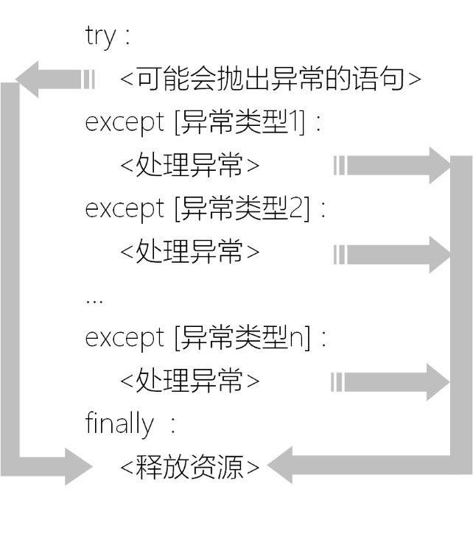
finally代码块流程

Slide 30
使用finally代码块示例代码如下：
# coding=utf-8
# 代码文件：chapter12/ch12.6.1.py
import datetime as dt
def read_date_from_file(filename):
try:
file = open(filename)
in_date = file.read()
in_date = in_date.strip()
date = dt.datetime.strptime(in_date, '%Y-%m-%d')
return date
except ValueError as e:
print('处理ValueError异常')
except FileNotFoundError as e:
print('处理FileNotFoundError异常')
except OSError as e:
print('处理OSError异常')
finally: ①
file.close() ②
date = read_date_from_file('readme.txt')
print('日期 = {0}'.format(date))

Slide 31
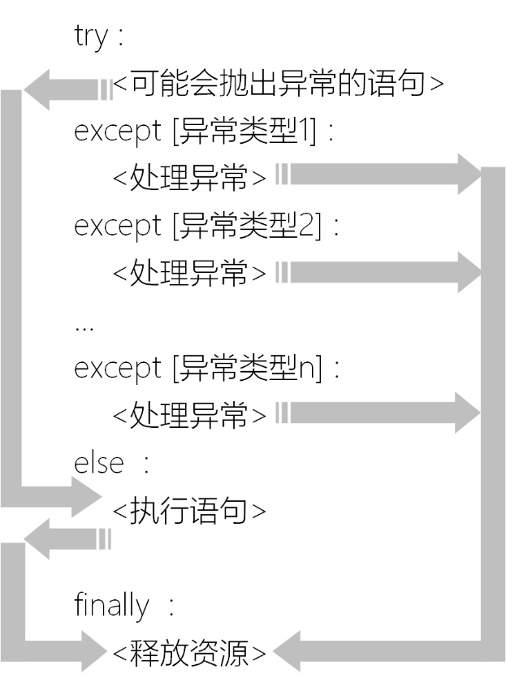
11.6.2 else代码块

Slide 32
修改示例代码如下：
# coding=utf-8
# 代码文件：chapter12/ch12.6.2.py
import datetime as dt
def read_date_from_file(filename):
try:
file = open(filename) ①
except OSError as e:
print('打开文件失败')
else: ②
print('打开文件成功')
try:
in_date = file.read()
in_date = in_date.strip()
date = dt.datetime.strptime(in_date, '%Y-%m-%d')
return date
except ValueError as e:
print('处理ValueError异常')
except OSError as e:
print('处理OSError异常')
finally: ③
file.close()
date = read_date_from_file('readme.txt')
print('日期 = {0}'.format(date))

Slide 33
11.6.3 with as代码块自动资源管理
# coding=utf-8
# 代码文件：chapter12/ch12.6.3.py
import datetime as dt
def read_date_from_file(filename):
try:
with open(filename) as file: ①
in_date = file.read()
in_date = in_date.strip()
date = dt.datetime.strptime(in_date, '%Y-%m-%d')
return date
except ValueError as e:
print('处理ValueError异常')
except OSError as e:
print('处理OSError异常')
date = read_date_from_file('readme.txt')
print('日期 = {0}'.format(date))

Slide 34
11.7 自定义异常类

Slide 35
实现自定义异常类示例代码如下：
# coding=utf-8
# 代码文件：chapter12/ch12.7.py
class MyException(Exception):
def __init__(self, message): ①
super().__init__(message) ②

Slide 36
11.8 显式抛出异常

Slide 37
修改示例代码如下：
# coding=utf-8
# 代码文件：chapter12/ch12.8.py
import datetime as dt
class MyException(Exception):
def __init__(self, message):
super().__init__(message)
def read_date_from_file(filename):
try:
file = open(filename)
in_date = file.read()
in_date = in_date.strip()
date = dt.datetime.strptime(in_date, '%Y-%m-%d')
return date
except ValueError as e:
raise MyException('不是有效的日期') ①
except FileNotFoundError as e:
raise MyException('文件找不到') ②
except OSError as e:
raise MyException('文件无法打开或无法读取') ③
date = read_date_from_file('readme.txt')
print('日期 = {0}'.format(date))

Slide 38






